Slide 1
AI Agent for Smart Farming Advice
CAPSTONE PROJECT
Presented By:
Aayush Bijalwan
Dr APJ Abdul Kalam Institute Of Technology Tanakpur
Computer Science & Engineering

Slide 2
OUTLINE
Problem Statement
Proposed System/Solution
System Development Approach
Result (Output Image)
Conclusion
Future Scope
References

Slide 3
Problem Statement
Farmers in the rural areas are struggled to stay updated with the current market prices of crops and they do not know the correct pest control measures according to their soil type and weather condition. Manually reviewing, filtering, and synthesizing information across multiple domains is time-consuming and inefficient.

Slide 4
Proposed Solution
This agent will significantly reduce the challenge of predicting the crop recommendation, mandi price and weather report, help early-stage farmers to get knowledge more accessible and actionable. This involves leveraging data analytics and machine learning techniques to forecast weather patterns accurately. The solution will consist of the following components:
1. Market analysis over price for specific crop or vegetables.
2. Recommendation of crop based on weather report and soil type.
3. Query Handling: Responds promptly and accurately to inquiries about crop details, mandi prices, weather report, etc.
4. User Guidance: Offers step-by-step assistance on government schemes, pest control steps, and soil testing.
5. Feedback Mechanism: Incorporates user feedback to continuously improve response accuracy and user satisfaction.

Slide 5
System Approach
This section outlines the overall strategy and methodology for developing and implementing the AI Agent for Smart Farming Advice chatbot. Here's a suggested structure for this section:
System requirements : Compatible with modern web browsers and mobile devices.
Technology Used: IBM Watsonx Assistant for natural language processing, RAG and IBM Granite.

Slide 6
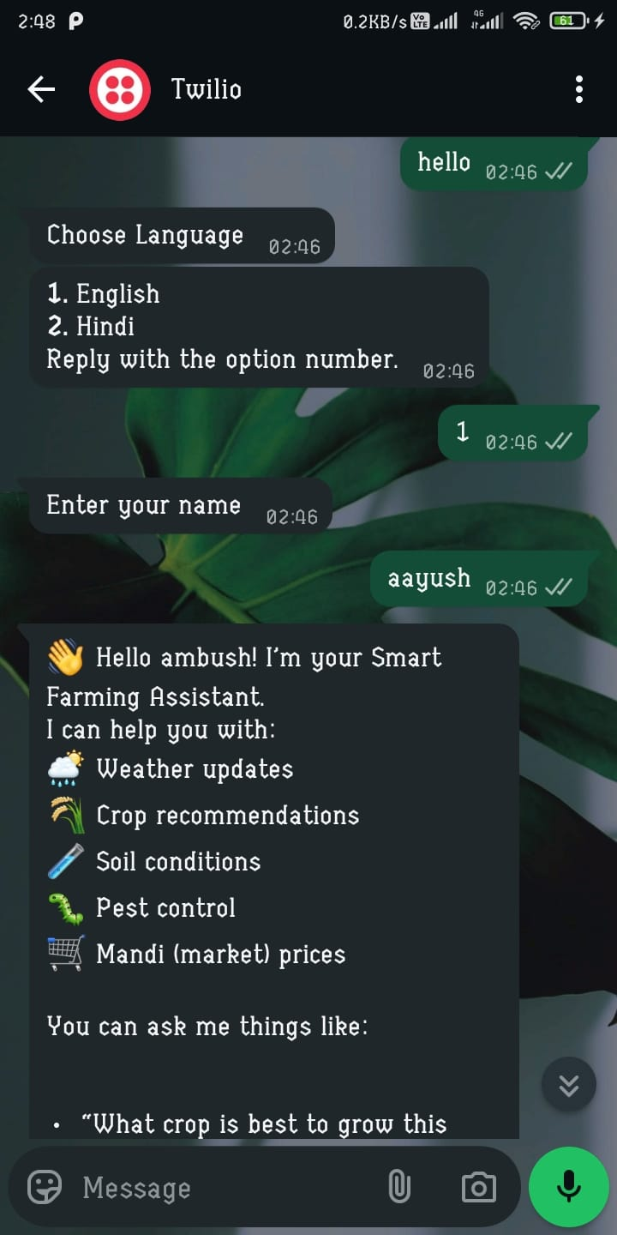
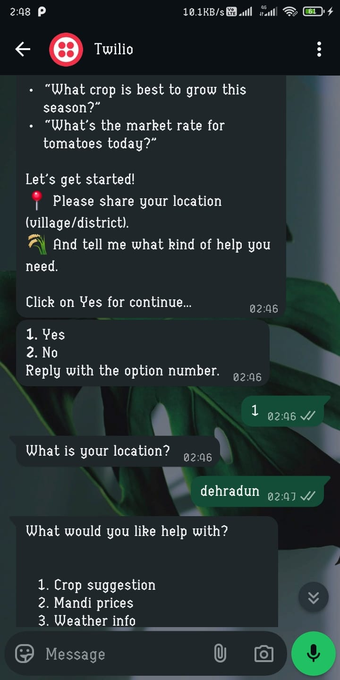
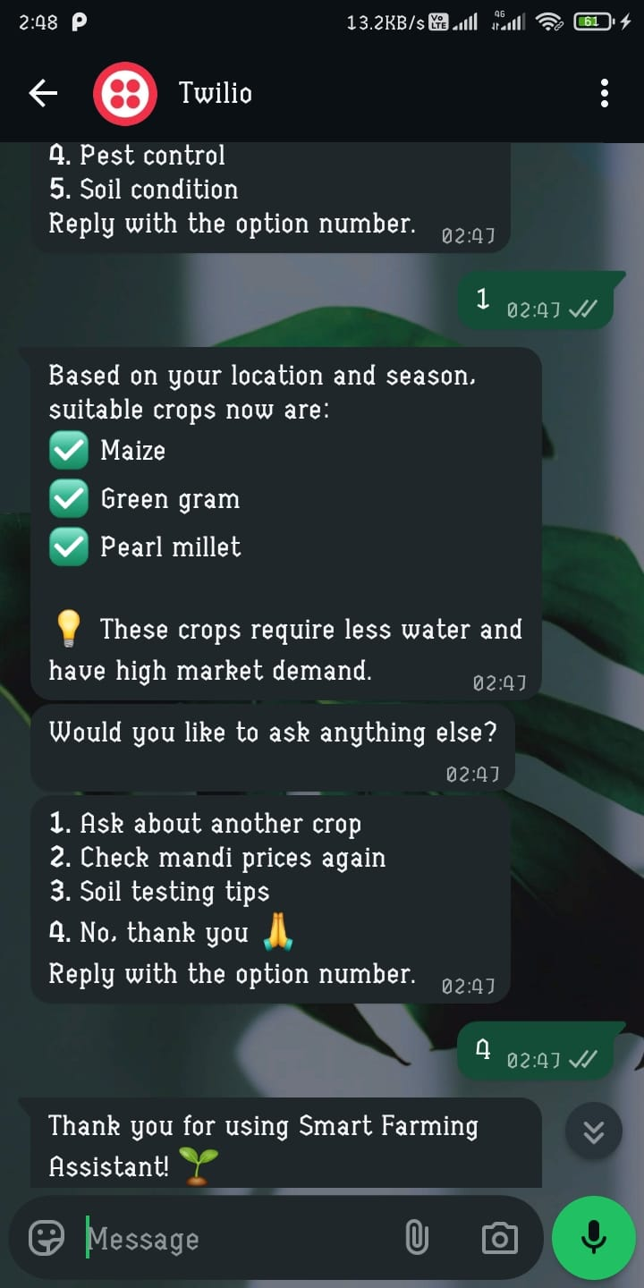
Result

Slide 7
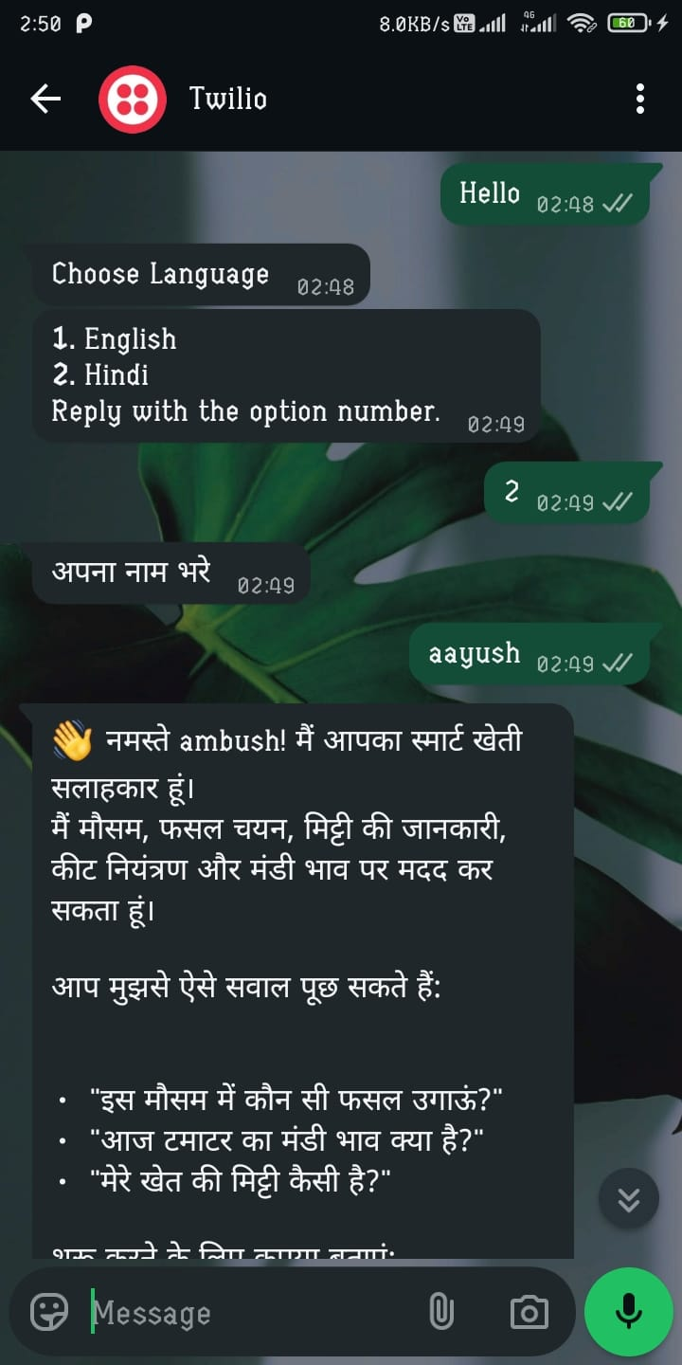
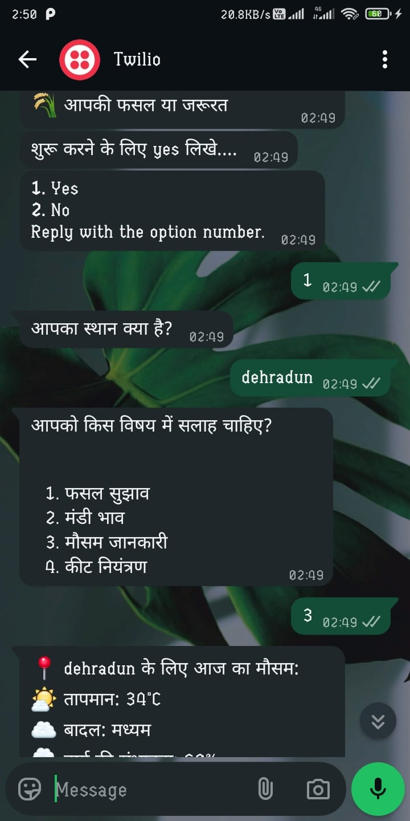
Result

Slide 8

pRoject link:-
Aayushbijalwan16/AICTE-EDUNET-IBM: AICTE EDUNET IBM Internship Project
Testing link :- http://wa.me/+14155238886?text=join %20traffic-ago
Step 1 : - Enter “Hello”
And bot will start.
Testing Link only valid till 07 Aug 2025.

Slide 9
Conclusion
The agent can generate crop recommendation based on soil type, weather condition.
It saves time of Farmer by retrieving trusted data on current market prices from agricultural departments.

Slide 10
Future scope
Multilingual Chat support
Personalized Assistance
Real-Time Collaboration Features

Slide 11
References
IBM Watsonx Assistant tutorial
Chat GPT for adding steps in chatbot

Slide 12
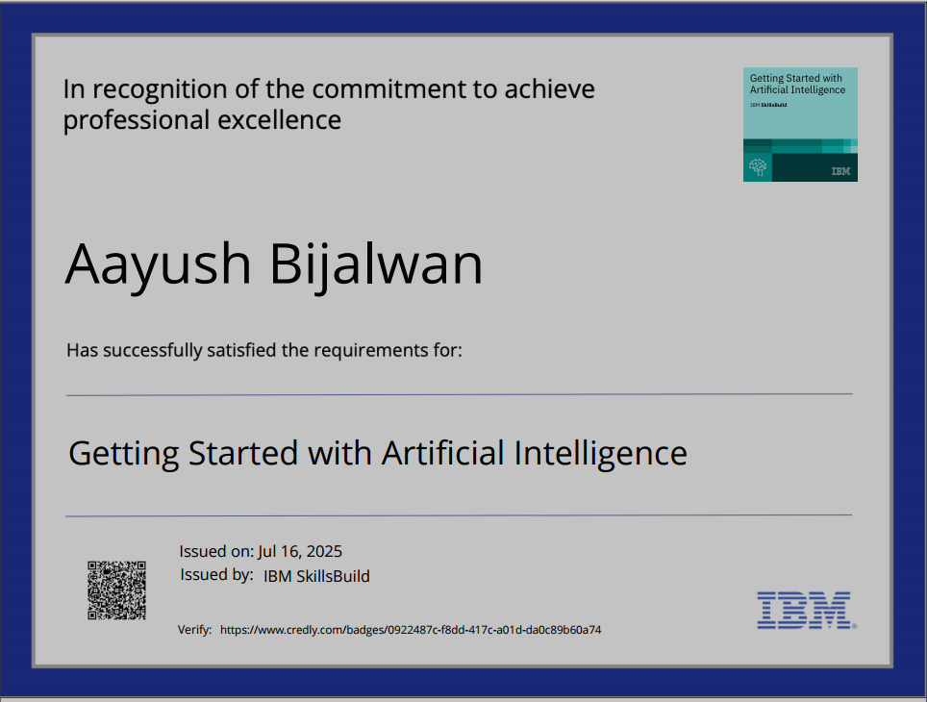
IBM Certifications

Slide 13
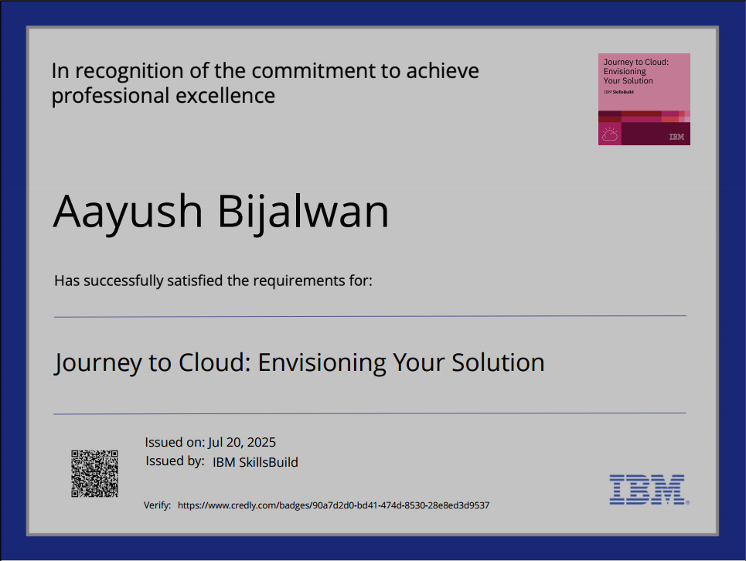
IBM Certifications

Slide 14
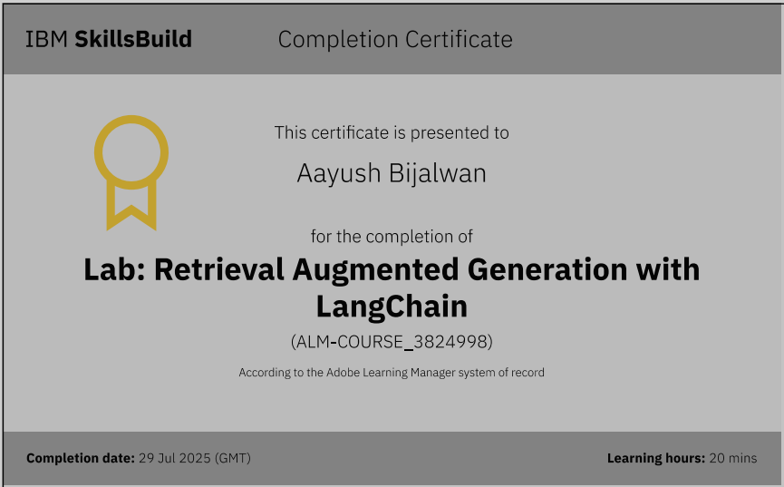
IBM Certifications

Slide 15
THANK YOU

